Slide 1


Slide 1
TABLEAU
NAME- SHIVANGI GUPTA
P.G DIPLOMA IN DATA SCIENCE
ASSISTANT PROFESSOR
NTISH PATIL

Slide 2
CONTENT
Introduction
Types of Data in Tableau
Visual Analytics
Filters in Tableau
Charts and Graphs
Calculations in Tableau
Products offered by Tableau
Advantages & Disadvantages
Tableau Public VS Tableau Desktop
Projects

Slide 3
Introduction
INSIGHTS
Tableau is a powerful tool used for data analysis, visualization.
It allows creating amazing and interactive visualization and that too without coding.
It is very famous as it can take in data and produce the required data visualization output in a very short time.
It can elevate your data into insights that can be used to drive your action in the future.

Slide 4
Types of data
String Values
Integer Values
#
Boolean Values
T|F
Data Values
Geographical Values
Date & Time Values

Slide 5
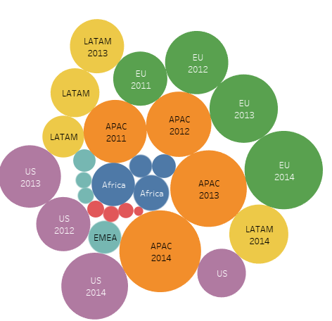
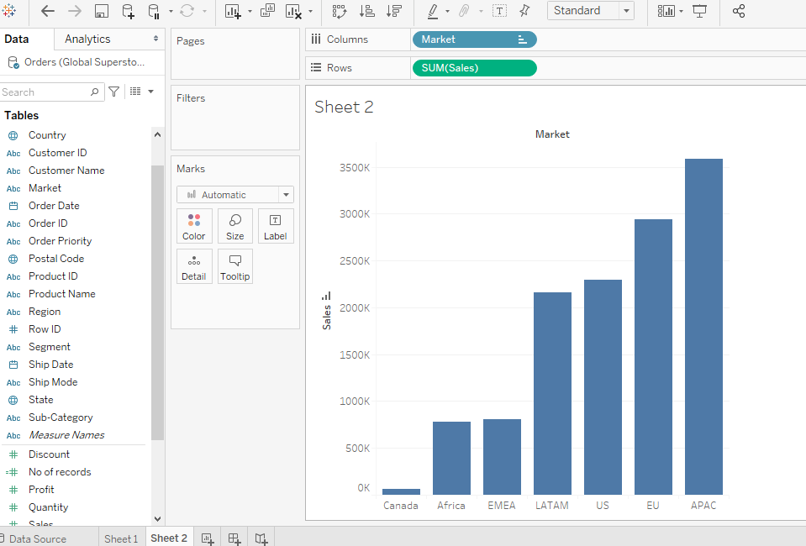
Visual analytics
Visual analytics is the representation and presentation of data that explicit our visual perception abilities in order to amplify cognition.
It is a means of exploring and understanding data.
It supports and accelerates the analysis process itself.
You can ask a question, get the answer, and ask follow-up questions—all within a visual interface.
A story unfolds from one visual summary to another. Later, you can retrace the story to rethink, explore further, and share.
In short, visual analytics allows you to go in any direction with your thoughts while you view and interact directly with the data.

Slide 6


Products offered by tableau
1. Tableau desktop
2. Tableau server
3. Tableau online
4.Tableau Reader
5.Tableau Public

Slide 7

Slide 6
ADVANTAGES OF TABLEAU
DISADVANTAGES OF TABLEAU
Data Visualization
Quickly Create Interactive Visualization
Comfortable in Implementation
Tableau can Handle Large Amounts of Data
Use of other Scripting Language in Tableau
Mobile Support and Responsive Dashboard
Scheduling of Reports
No Custom Visual Imports
Custom Formatting in Tableau
Static and Single Value Parameter
Screen Resolution on Tableau Dashboards

Slide 8
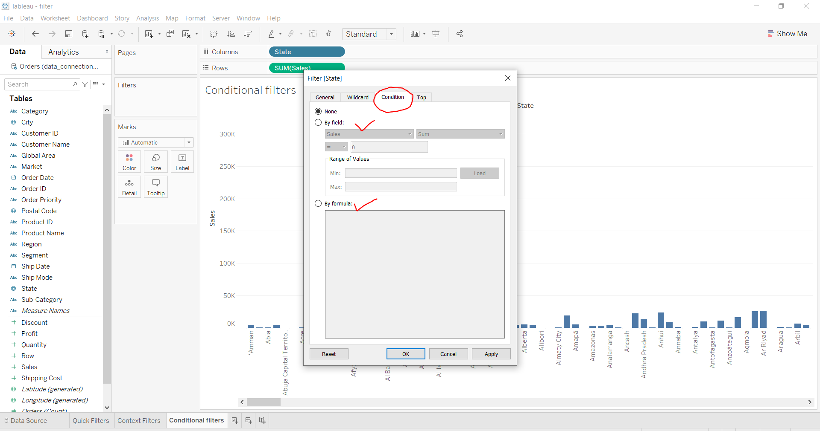
Filters in tableau
Extract Filter(Hide and Unhide rows)
Data Source Filter
Context Filter
Dimension Filter
Measure Filter (Sum, Avg , Median, Standard Deviation, etc.)
Table Calculation Filter

Slide 9
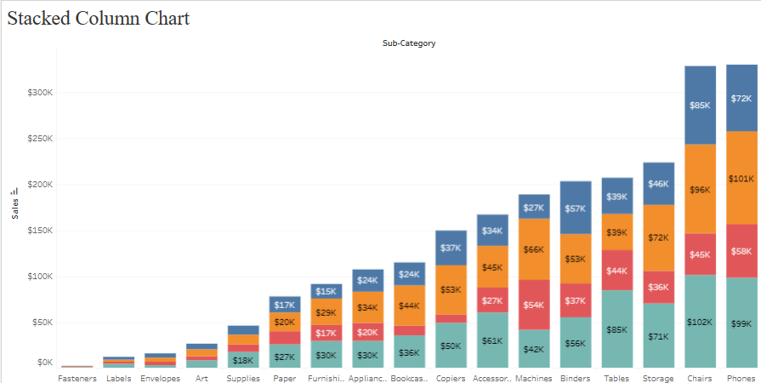
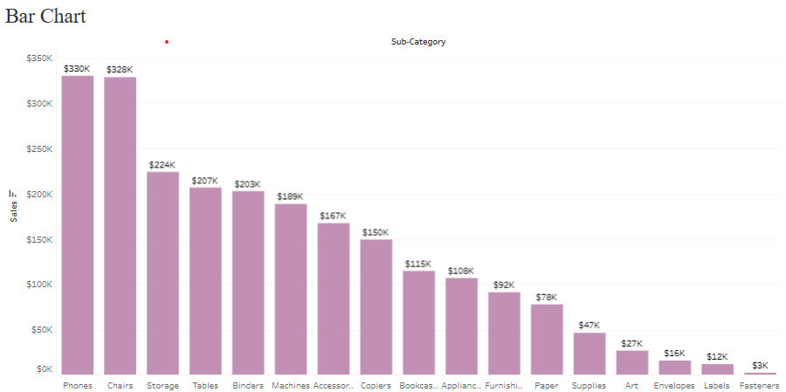
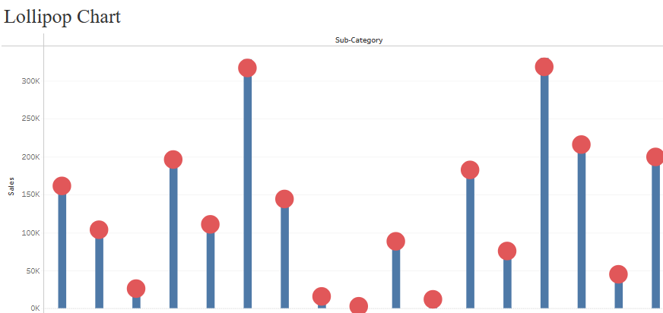
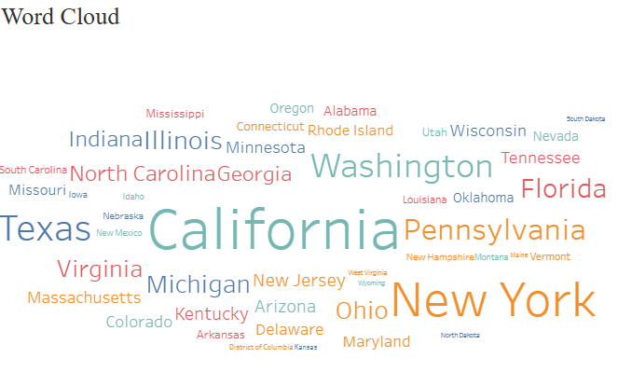
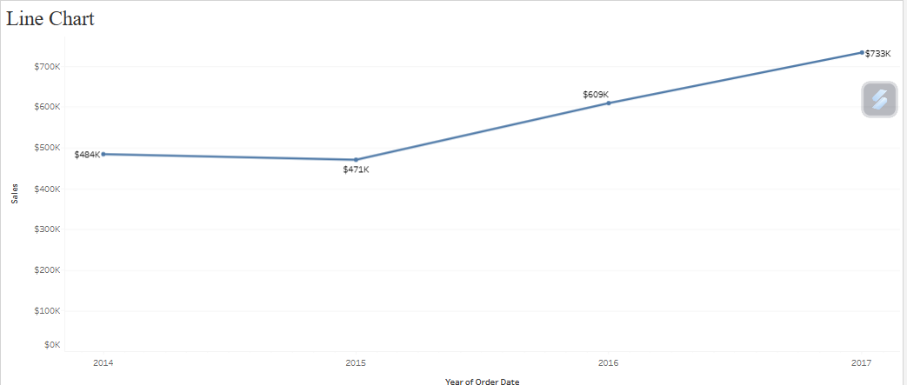
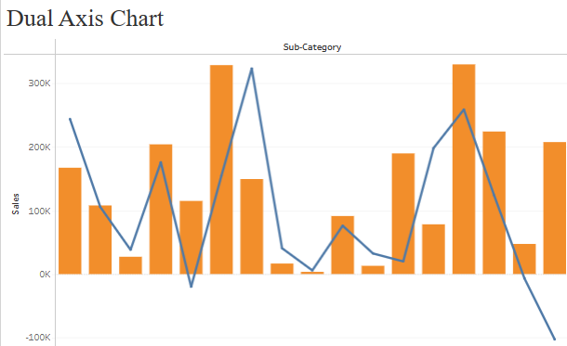
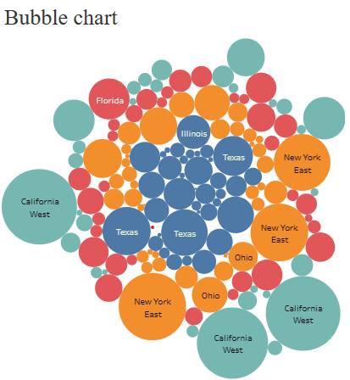
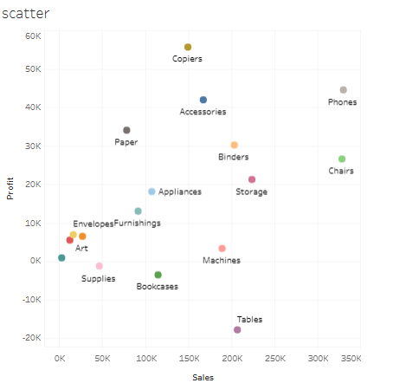
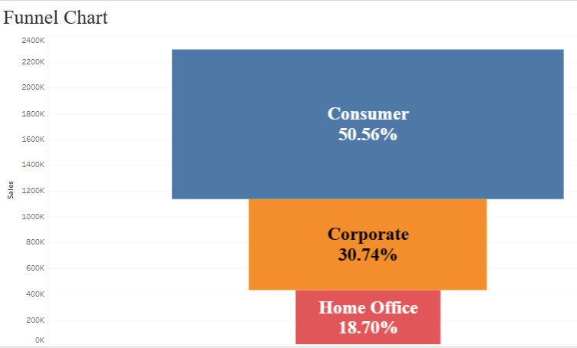
Charts and graphs

Slide 10
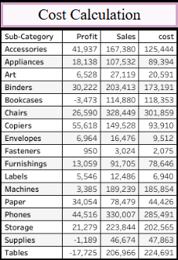
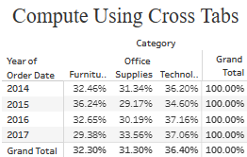
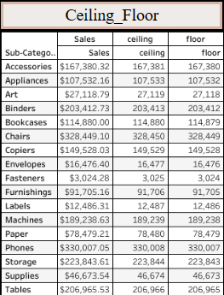
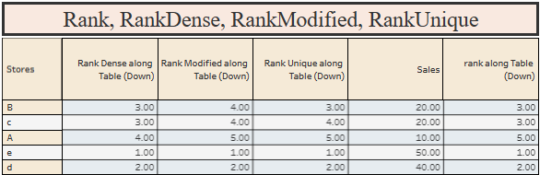
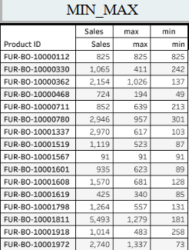
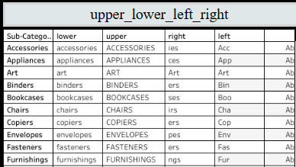
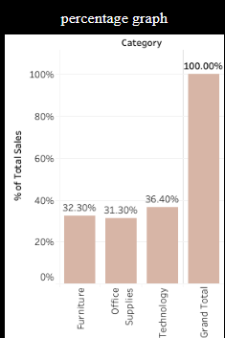
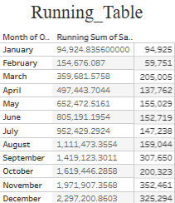
Calculations in Tableau

Slide 11
TABLEAU PUBLIC VS TABLEAU DESKTOP
Cost | Tableau Public is a free version of the Tableau visualization program. It grants access to the majority of the software’s features. It is possible to generate visualizations. and connect them to CSV, Text, and Excel files | Tableau Desktop is a paid data visualization software that allows users to view and comprehend data in only minutes. The professional version of this software is capable of transforming, processing, and storing vast quantities of data and is accountable for an organization’s data-driven decision-making.
Data Sources | Tableau Public Edition is only compatible with Microsoft Excel data, numerous text file types, statistical files, Google sheets, and web data connectors. You can not connect to cloud-based data sources. | Tableau Desktop can connect to on-premises and cloud-based data, including big data, SQL databases, spreadsheets, and cloud applications such as Google Analytics and Salesforce. Access different data and merge them without writing code.
Security | Workbook gets public as soon as you publish them. | Workbooks are private. One would need an access link to see your work.
Data Accessibility | Tableau Public App has limited data accessibility, you can access the data for up to 1 Million Rows only. | Tableau Desktop can store, analyse, and distribute an unlimited number of rows of data.

Slide 12
PROJECTS
Airbnb
UT Mart Sales
Covid19
Superstore
HR attrition

Slide 13
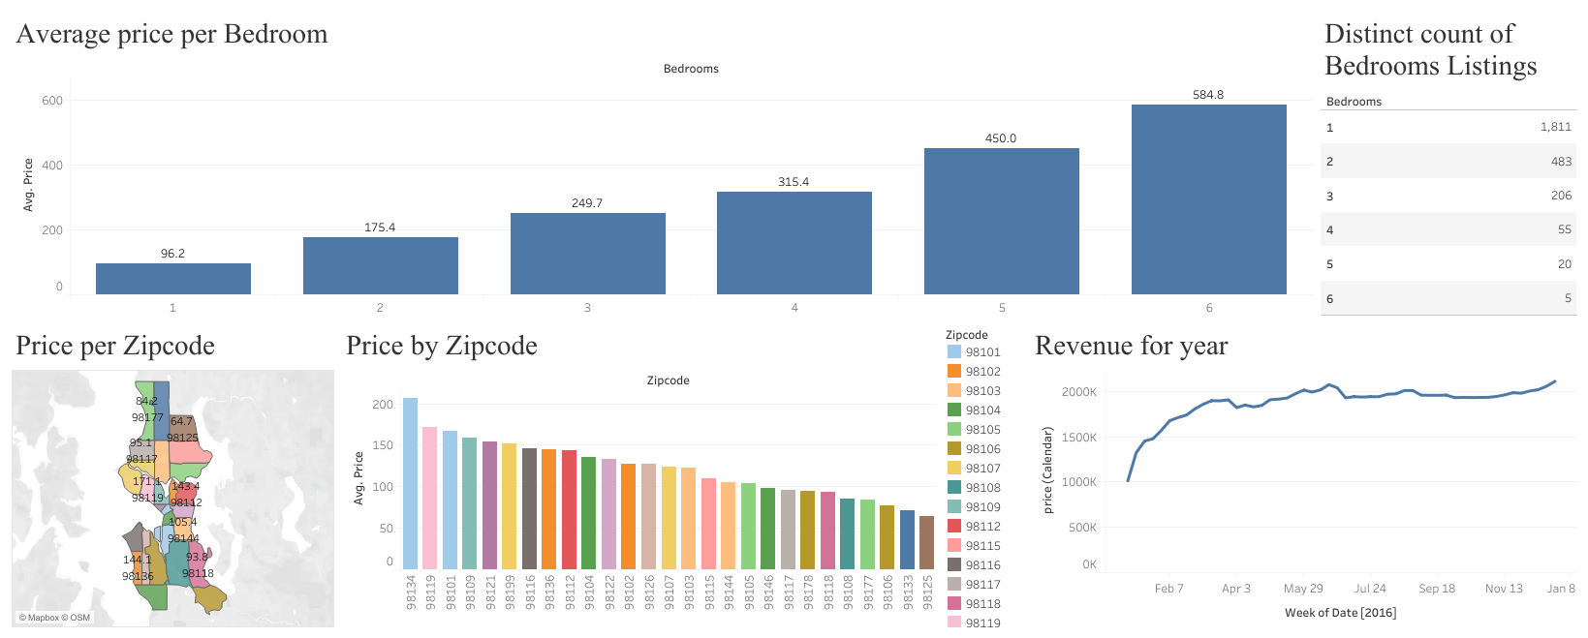
AirBnB

Slide 14
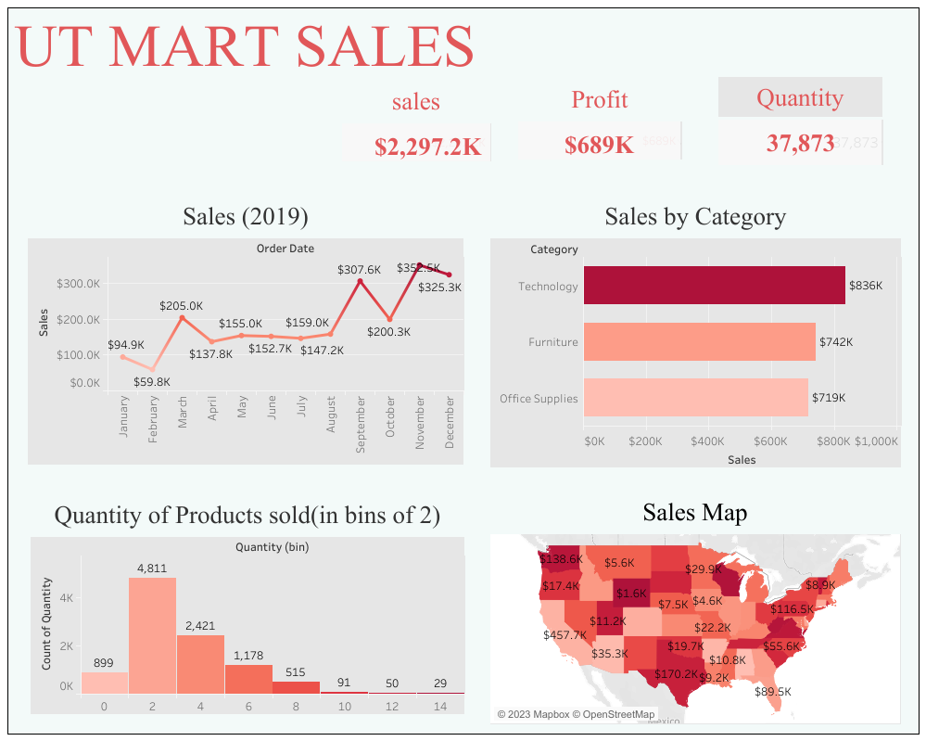

Slide 15
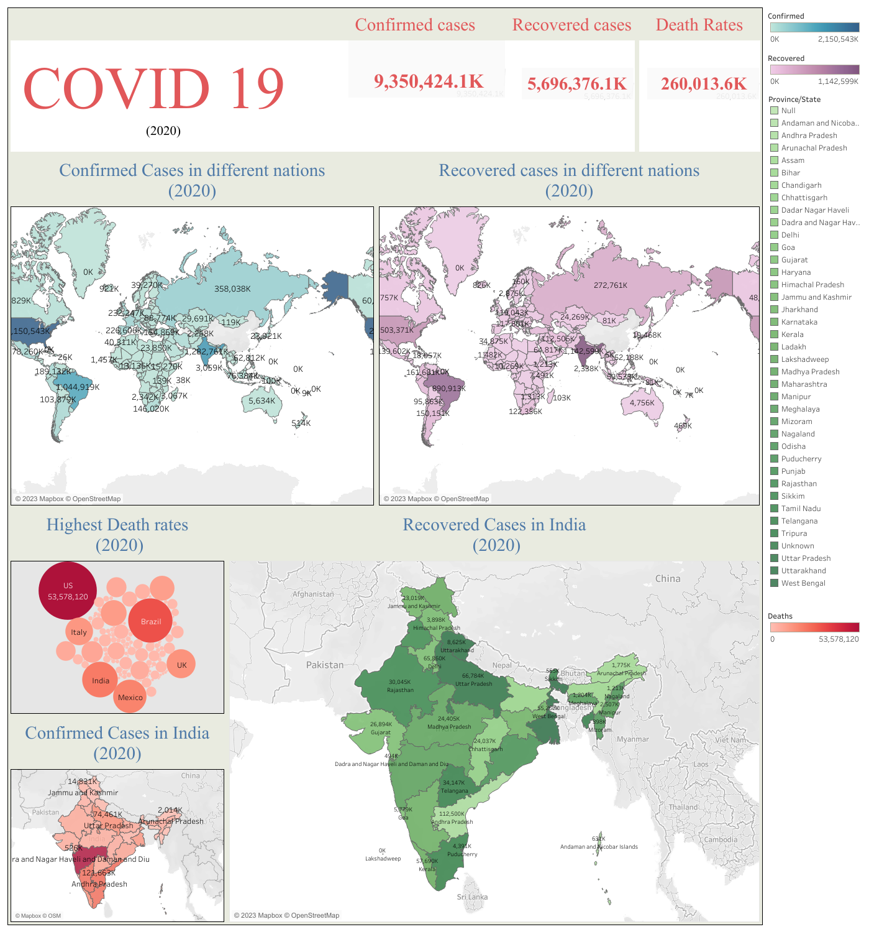

Slide 16
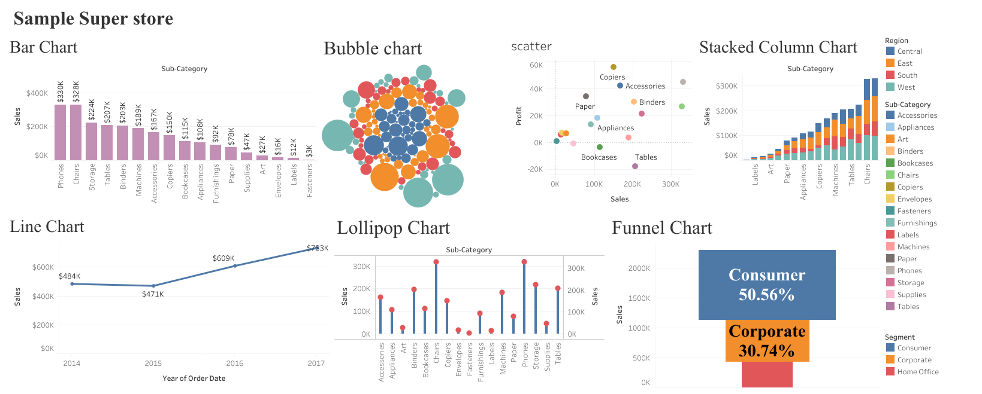

Slide 17

Slide 10
THANKYOU

